Slide 1
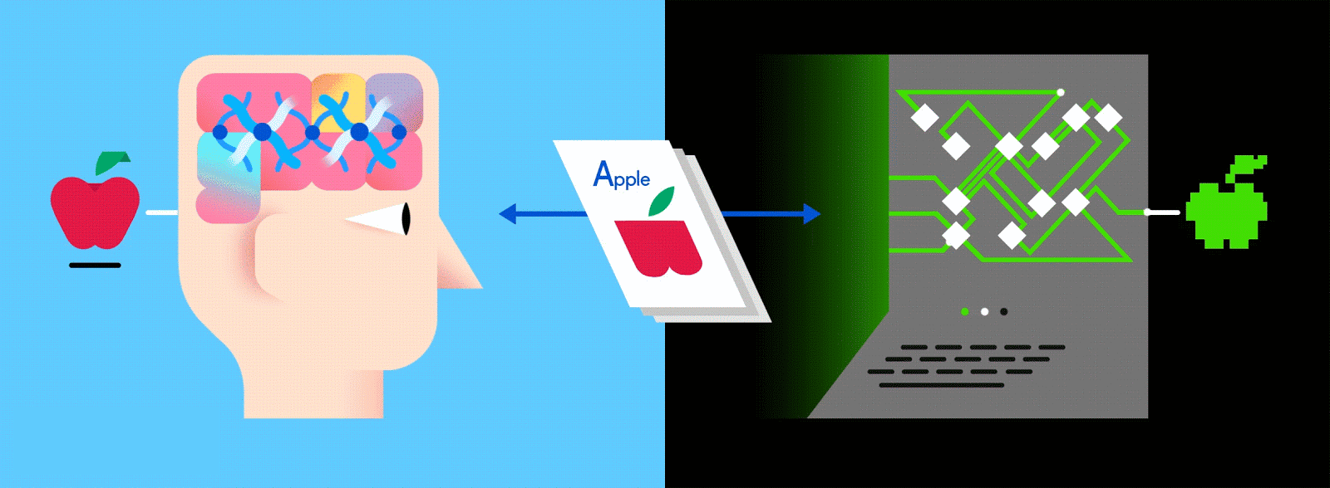
Introduction to Machine Learning

Slide 2

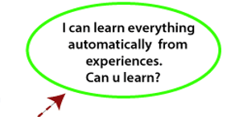

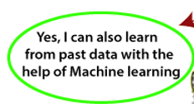
Introduction
Human
Machine

Slide 3
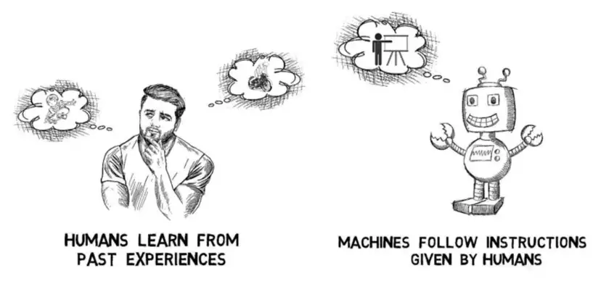
What is Machine Learning?
Machine Learning
Learn from past experiences
Improve the performance of intelligent programs

Slide 4

Introduction to Machine Learning Cont’d
What is the name of the shape? And Color?
Kid ?...

Slide 5
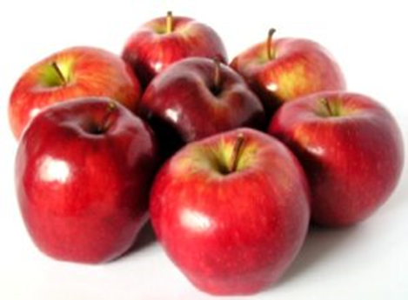
Introduction to Machine Learning Cont’d
Example
Let’s suppose one day you went shopping for apples. The vendor had a cart full of apples from where you could handpick the fruit, get it weighed and pay according to the rate fixed (per Kg).

Slide 6
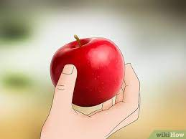
Introduction to Machine Learning Cont’d
Task
How will you choose the best apples?

Slide 7
Introduction to Machine Learning Cont’d
Learning from experience
Set of learning that human gains from their experience of shopping for apples.
Learning 1: Bright red apples are sweeter than pale ones
Learning 2: The smaller and bright red apples are sweet only half the time
Learning 3: Small, pale ones aren’t sweet at all
Learning 4: Crispier apples are juicier
Learning 5: Green apples are tastier than red ones
Learning 6: You don’t need apples anymore

Slide 8
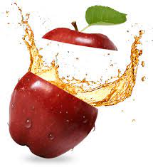
Introduction to Machine Learning Cont’d
What if you have to write code for it?
Now, imagine you were asked to write a computer program to choose your apples.
You might write the following rules/algorithm:
if (bright red) and if (size is big): Apple is sweet.
if (crispy): Apple is juicy.

Slide 9
Introduction to Machine Learning Cont’d
You would use these rules to choose the apples.
But every time you make a new observation (what if you had to choose oranges, instead) from your experiments, you have to modify the list of rules manually.
You have to understand the details of all the factors affecting the quality of the fruit.

Slide 10
Introduction to Machine Learning Cont’d
If the problem gets complicated enough, it might get difficult for you to make accurate rules by hand that covers all possible types of fruit.
This is where Machine Learning Algorithms come into the picture.
So instead of you writing the code, what you do is you feed data to the generic algorithm, and the algorithm / machine builds the logic based on the given data.

Slide 11
Introduction to Machine Learning Cont’d
Traditional programming paradigm
Machine Learning paradigm

Slide 12
Introduction to Machine Learning Cont’d
Examples of Successful Applications of Machine Learning
Learning to recognize spoken words
Learning to drive an autonomous vehicle
Learning to classify new astronomical structures
Learning to play world-class backgammon

Slide 13
Introduction to Machine Learning Cont’d
Why is Machine Learning Important?
Some tasks cannot be defined well, except by examples (e.g., recognizing people).
Relationships and correlations can be hidden within large amounts of data. Machine Learning/Data Mining may be able to find these relationships.
Human designers often produce machines that do not work as well as desired in the environments in which they are used.
The amount of knowledge available about certain tasks might be too large for explicit encoding by humans (e.g., medical diagnostic).
Environments change over time.
New knowledge about tasks is constantly being discovered by humans. It may be difficult to continuously re-design systems “by hand”.

Slide 14
Introduction to Machine Learning Cont’d
Areas of Influence for Machine Learning
Statistics: How best to use samples drawn from unknown probability distributions to help decide from which distribution some new sample is drawn?
Brain Models: Non-linear elements with weighted inputs (Artificial Neural Networks) have been suggested as simple models of biological neurons.
Adaptive Control Theory: How to deal with controlling a process having unknown parameters that must be estimated during operation?
Psychology: How to model human performance on various learning tasks?
Artificial Intelligence: How to write algorithms to acquire the knowledge humans are able to acquire, at least, as well as humans?
Evolutionary Models: How to model certain aspects of biological evolution to improve the performance of computer programs?

Slide 15
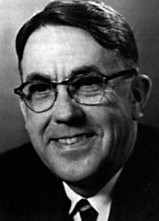
Introduction to Machine Learning Cont’d
Machine Learning Definition
Arthur Samuel (1959). Machine Learning:
A field of study that gives computers the ability to learn without being explicitly programmed.

Slide 16

Introduction to Machine Learning Cont’d
Tom Mitchell (1998)
Learning = Improving with experience at some task
– Improve over task T,
– With respect to performance measures, P
– Based on experience, E.
To have a well-defined learning problem, three features need to be identified:
1. The class of tasks
2. The measure of performance to be improved
3. The source of experience

Slide 17
Introduction to Machine Learning Cont’d
Example : Spam Filtering
Spam - all emails the user does not want to receive and has not asked to receive.
T: Identify Spam Emails
P:
% of spam emails that were filtered
% of ham/ (non-spam) emails that were incorrectly filtered-out
E: a database of emails that were labelled by users

Slide 18
Introduction to Machine Learning Cont’d
Example : A checkers learning problem
Task T: playing checkers
Performance measure P: percent of games won against opponents
Training experience E: playing practice games against itself
Example : A handwriting recognition learning problem
Task T: Recognizing and classifying handwritten words within images
Performance measure P: Percent of words correctly classified
Training experience E: A database of handwritten words with given classifications

Slide 19
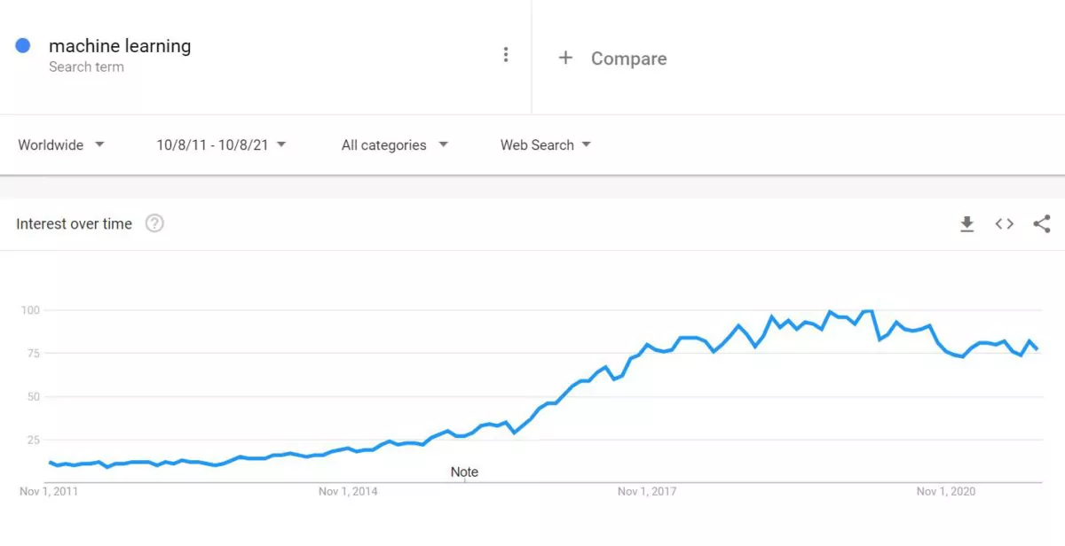
Introduction to Machine Learning Cont’d
Why Now?
Flood of available data (especially with the advent of the Internet)
Increasing computational power.
Growing progress in available algorithms and theory developed by researchers
Increasing support from industries.

Slide 20
Introduction to Machine Learning Cont’d
Why Now? Cont’d
Lack of human expertise
Ex: The examples can be navigations in unknown territories or spatial planets.
Dynamic scenarios
Ex: Network connectivity and availability of infrastructure in an organization.
Difficulty in translating expertise into computational tasks
Ex: The domains of speech recognition, cognitive tasks

Slide 21
Introduction to Machine Learning Cont’d
Choice of P very important!! - Expert system or human comprehension? - Datamining!!
Broad enough to include most tasks that we would call “learning tasks” but also programs that improve from experience in quite straightforward ways (rote learning or caching)!
A database system that allows users to update data entries - it improves its performance at answering database queries, based on the experience gained from databases updates (same issue as what is intelligence)

Slide 22
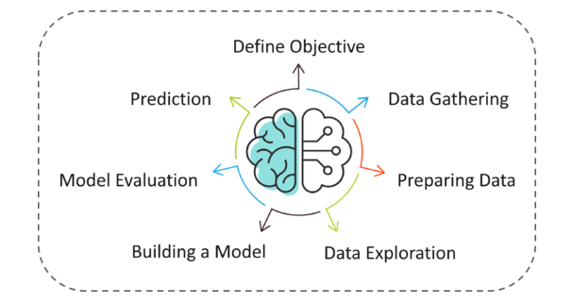
Introduction to Machine Learning Cont’d
Machine Learning

Slide 23
Machine Learning Process
Data Collection: Collect the data that the algorithm will learn from.
Data Preparation: Format and engineer the data into the optimal format, extracting important features and performing dimensionality reduction.
Training: Also known as the fitting stage, this is where the Machine Learning algorithm actually learns by showing it the data that has been collected and prepared.
Evaluation: Test the model to see how well it performs.
Tuning: Fine-tune the model to maximize it’s performance.

Slide 24
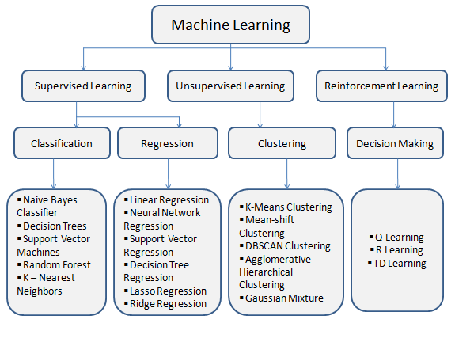
Introduction to Machine Learning Cont’d
Machine learning Tasks

Slide 25
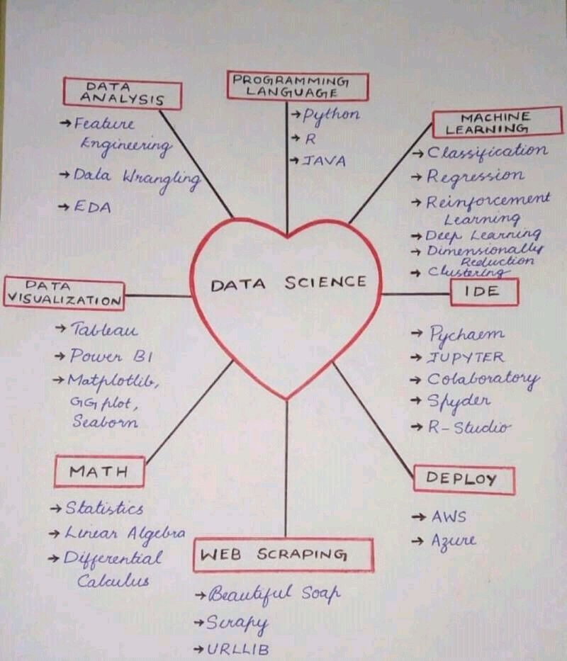
What is Data Science?

Slide 26
Introduction to Machine Learning Cont’d
Terminologies
Dataset: A set of data examples, that contain features important to solving the problem.
Features: Important pieces of data that help us understand a problem. These are fed into a Machine Learning algorithm to help it learn
Model: The representation (internal model) of a phenomenon that a Machine Learning algorithm has learned. It learns this from the data it is shown during training. The model is the output you get after training an algorithm. For example, a decision tree algorithm would be trained and produce a decision tree model.

Slide 27
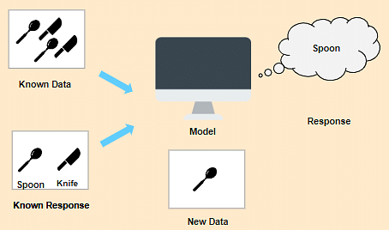
Introduction to Machine Learning Cont’d
Examples of Various Learning Paradigms, Perspectives and Issues
Supervised learning
In Supervised Learning, the machine learns under supervision. It contains a model that is able to predict with the help of a labeled dataset. A labeled dataset is one where you already know the target answer.

Slide 28
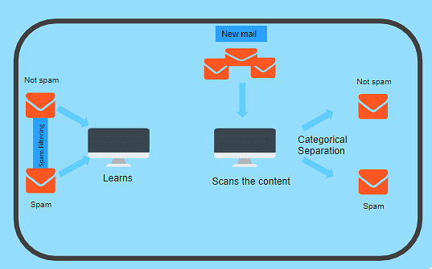
Introduction to Machine Learning Cont’d
Supervised learning Cont’d
Supervised learning can be further divided into two types:
Classification
Regression
Classification - Supervised Learning
Classification is used when the output variable is categorical i.e. with 2 or more classes. For example, yes or no, male or female, true or false, etc.

Slide 29
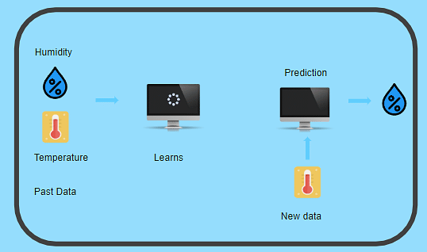
Introduction to Machine Learning Cont’d
Supervised learning Cont’d
Regression - Supervised Learning
Regression is used when the output variable is a real or continuous value.
In this case, there is a relationship between two or more variables i.e., a change in one variable is associated with a change in the other variable.
For example, salary based on work experience or weight based on height, etc.

Slide 30
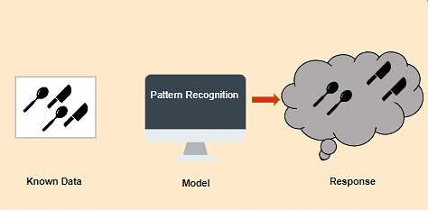
Introduction to Machine Learning Cont’d
Unsupervised Learning
In Unsupervised Learning, the machine uses unlabeled data and learns on itself without any supervision.
The machine tries to find a pattern in the unlabeled data and gives a response.

Slide 31
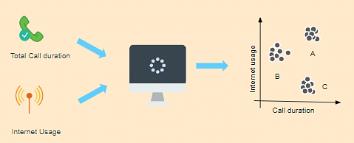
Introduction to Machine Learning Cont’d
Unsupervised Learning Cont’d
Unsupervised learning can be further grouped into types:
Clustering
Association
Clustering - Unsupervised Learning
Clustering is the method of dividing the objects into clusters that are similar between them and are dissimilar to the objects belonging to another cluster.
For example, finding out which customers made similar product purchases.

Slide 32
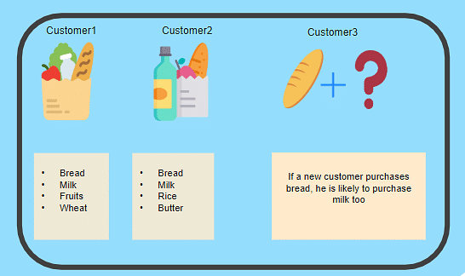
Introduction to Machine Learning Cont’d
Unsupervised Learning Cont’d
Association - Unsupervised Learning
Association is a rule-based machine learning to discover the probability of the co-occurrence of items in a collection.
For example, finding out which products were purchased together.

Slide 34

Introduction to Machine Learning Cont’d
Reinforcement Learning
Reinforcement Learning is a part of Machine learning where an agent is put in an environment and he learns to behave in this environment by performing certain actions and observing the rewards which it gets from those actions.
Imagine that you were dropped off at an isolated island! What would you do?
Panic?
Yes, of course, initially we all would.
But as time passes by, you will learn how to live on the island.
You will explore the environment, understand the climate condition, the type of food that grows there, the dangers of the island, etc.
This is exactly how Reinforcement Learning works, it involves an Agent (you, stuck on the island) that is put in an unknown environment (island), where he must learn by observing and performing actions that result in rewards.

Slide 35

Introduction to Machine Learning Cont’d
Reinforcement Learning

Slide 36
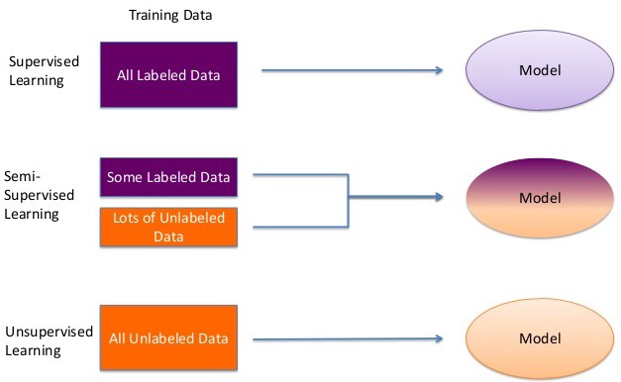
Introduction to Machine Learning Cont’d

Slide 37
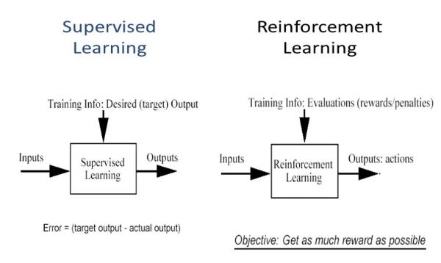
Introduction to Machine Learning Cont’d

Slide 38
Introduction to Machine Learning Cont’d
Major Approaches
Decision tree learning -Decision tree learning uses a decision tree as a predictive model, which maps observations about an item to conclusions about the item's target value.
A decision tree is a decision support tool that uses a tree-like graph or model of decisions and their possible consequences, including chance event outcomes, resource costs, and utility. It is one way to display an algorithm that only contains conditional control statements.

Slide 39
Major Approaches Cont’d
Association rule learning - Association rule learning is a rule-based machine learning method for discovering interesting relations between variables in large databases. It is intended to identify strong rules discovered in databases using some measures of interestingness.

Slide 40
Major Approaches Cont’d
Artificial neural networks -An artificial neural network (ANN) learning algorithm, usually called "neural network" (NN), is a learning algorithm that is vaguely inspired by biological neural networks.
Computations are structured in terms of an interconnected group of artificial neurons, processing information using a connectionist approach to computation.
They are usually used to model complex relationships between inputs and outputs, to find patterns in data, or to capture the statistical structure in an unknown joint probability distribution between observed variables.

Slide 41
Major Approaches Cont’d
Deep learning - Falling hardware prices and the development of GPUs for personal use in the last few years have contributed to the development of the concept of deep learning which consists of multiple hidden layers in an artificial neural network.
This approach tries to model the way the human brain processes light and sound into vision and hearing. Some successful applications of deep learning are computer vision and speech recognition.

Slide 42
Major Approaches Cont’d
Support vector machines - Support vector machines (SVMs) are a set of related supervised learning methods used for classification and regression.
Given a set of training examples, each marked as belonging to one of two categories, an SVM training algorithm builds a model that predicts whether a new example falls into one category or the other.

Slide 43
Major Approaches Cont’d
Clustering - Cluster analysis is the assignment of a set of observations into subsets (called clusters) so that observations within the same cluster are similar according to some predesignated criterion or criteria, while observations drawn from different clusters are dissimilar. Different clustering techniques make different assumptions about the structure of the data.

Slide 44
Major Approaches Cont’d
Genetic algorithms - A genetic algorithm (GA) is a search heuristic that mimics the process of natural selection and uses methods such as mutation and crossover to generate new genotypes in the hope of finding good solutions to a given problem.
In machine learning, genetic algorithms found some uses in the 1980s and 1990s. Conversely, machine-learning techniques have been used to improve the performance of genetic and evolutionary algorithms.

Slide 45
Major Approaches Cont’d
Feature selection approach - Feature selection is the process of selecting an optimal subset of relevant features for use in model construction.
It is assumed the data contains some features that are either redundant or irrelevant, and can thus be removed to reduce calculation cost without incurring much loss of information. Common optimality criteria include accuracy, similarity, and information measures.

Slide 46
Machine Learning Techniques
classification: predict class from observations
clustering: group observations into meaningful” groups
Regression (prediction): predict value from observations

Slide 47
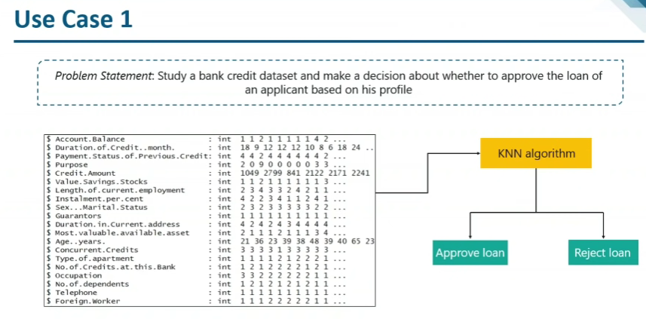

Slide 48
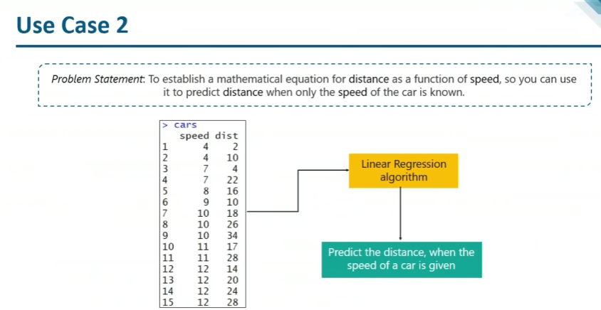

Slide 49
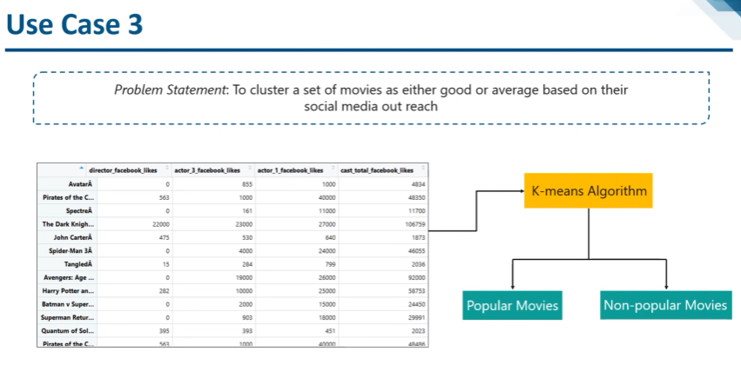

Slide 50
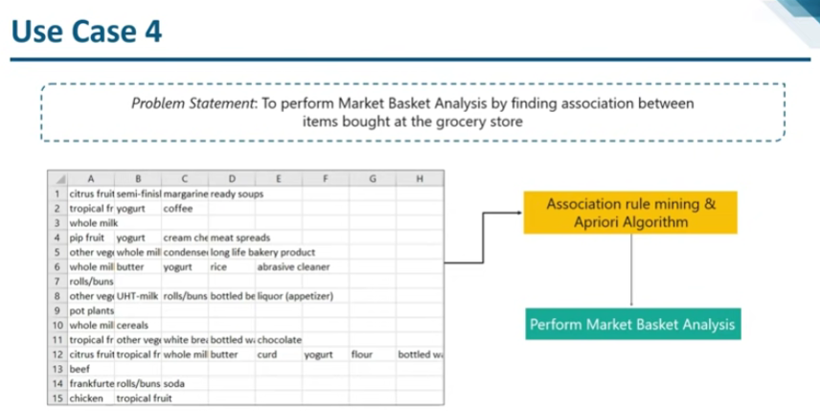

Slide 51
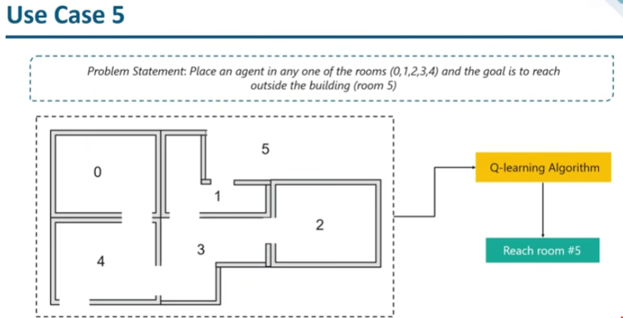

Slide 52
Applications
Agriculture
Adaptive websites
Bioinformatics
Cheminformatics
Classifying DNA sequences
Computational anatomy
Computer Networks
Telecommunication
Computer vision, including object recognition
Detecting credit-card fraud
General game playing
Information retrieval
Internet fraud detection
Linguistics
Marketing
Machine perception
Medical diagnosis

Slide 53
Applications
Economics
Insurance
Natural language processing
Optimization and metaheuristic
Online advertising
Recommender systems
Search engines
Sentiment analysis
Sequence mining
Software engineering
Speech and handwriting recognition
Financial market analysis
Structural health monitoring
Syntactic pattern recognition
Time series forecasting
User behavior analytics
Translation

Slide 54
Top 10 Current Applications of ML
Google Translator
Moley
NetFlix
Tesla
iPhone
Amazon
UBER Eats/ Swiggy
Facebook
Google maps
Kuka

Slide 55
Datasets
Kaggle Datasets - https://www.kaggle.com/datasets
UCI Machine Learning Repository:
https://archive.ics.uci.edu/ml/datasets.html
Amazon Datasets: https://registry.opendata.aws/usage-examples/

Slide 56
Datasets
Google’s Datasets Search Engine:
https://toolbox.google.com/datasetsearch?source=post_page---------------------------
Microsoft Datasets:
https://msropendata.com/?source=post_page---------------------------
Awesome Public Datasets Collection: https://github.com/awesomedata/awesome-public-datasets?source=post_page---------------------------

Slide 57
Datasets
Computer Vision Datasets:
https://www.visualdata.io/?source=post_page---------------------------
Government Datasets:
https://www.data.gov/?source=post_page---------------------------
https://data.gov.in/?source=post_page---------------------------
https://data.europa.eu/euodp/data/dataset?source=post_page---------------------------

